Slide 1
Introduction to TypeScript
Self.Conference
Bill Wagner

Slide 2




Who is Bill Wagner?
Author
Microsoft C# MVP
Microsoft Regional Director
Member C# ECMA Standardization Committee
http://thebillwagner.com

Slide 3

JavaScript has Good Parts

Slide 4
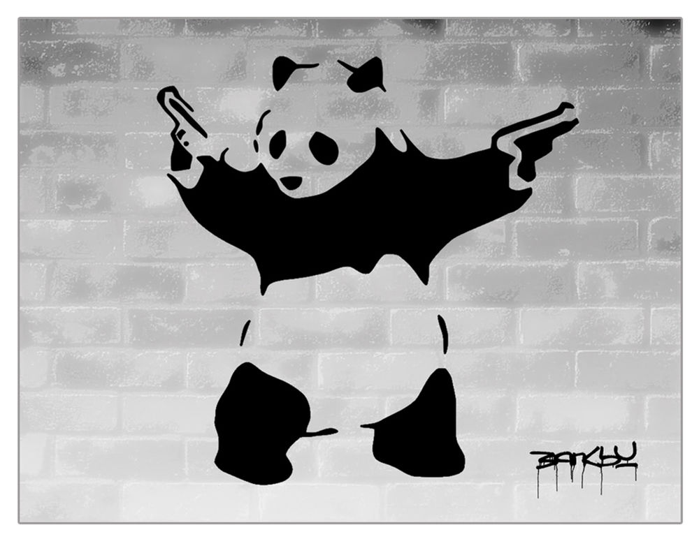
JavaScript has Bad Parts

Slide 5
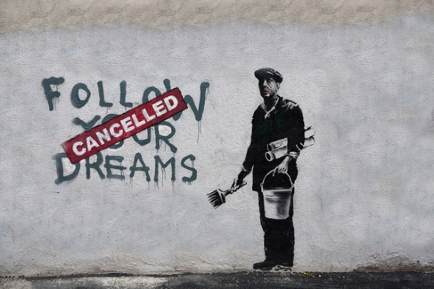
JavaScript has Limits

Slide 6

Enter TypeScript

Slide 7
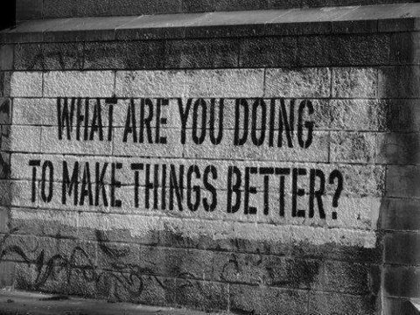
TypeScript makes JavaScript Better

Slide 8

TypeScript generates Idiomatic JavaScript

Slide 9
TypeScript: Productivity
Minimize Developer Mistakes
Promote Reuse
Scoping Names
Migration is possible

Slide 10
Minimize Mistakes
Static Type Annotations
Object Types
Type Inference
Type Assertions

Slide 11
Reuse
Interfaces
Structural Typing
Generics

Slide 12
Scoping
Modules

Slide 13

Migrating to TypeScript

Slide 14
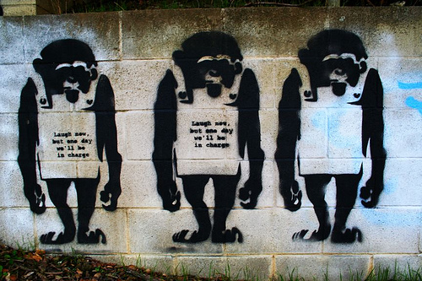
Valid JavaScript is Valid TypeScript

Slide 15
TypeScript Migrations
Any type
Null and undefined type

Slide 16
TypeScript Goals
Opt in to features
Be more productive
Create Great javascript

Slide 17







Humanitarian Toolbox Initiative
http://htbox.org
Crowd sourced design and
development process
Designed and driven by
established NGOs
Open Source repository
BE A HERO!

Slide 18

http://www.microsoft.com/net/codelegion/

Slide 19
Resources
http://www.typescriptlang.org
https://github.com/BillWagner/SelfConferenceDemos
http://thebillwagner.com
Bill.w.wagner@outlook.com @billwagner
http://htbox.org
https://github.com/HTBox/crisischeckin

